Slide 1
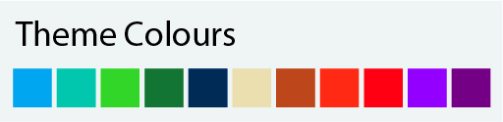
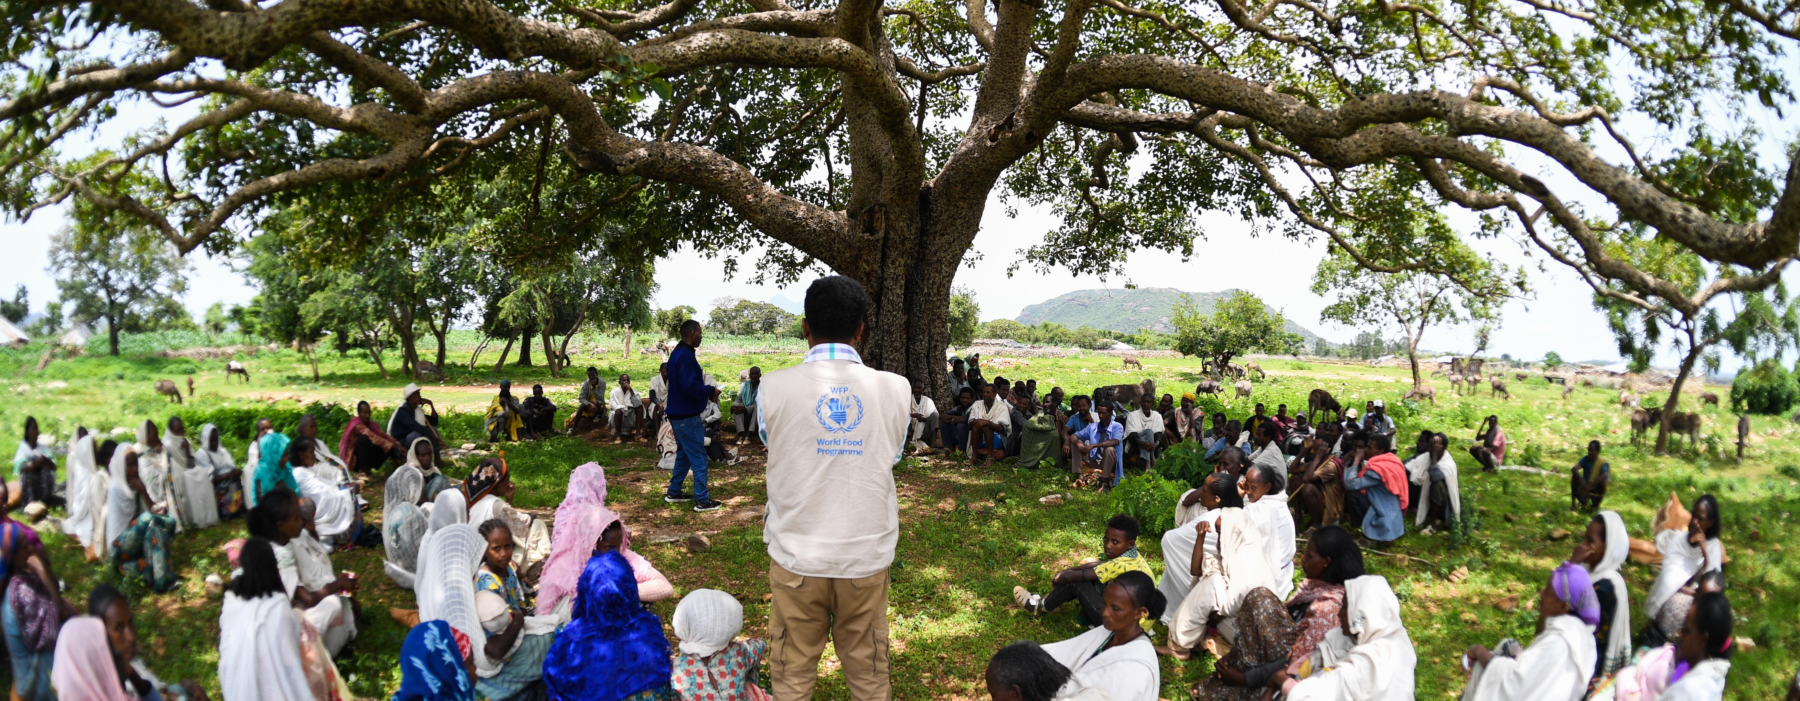

Launch of the Targeting Strategy Effort
Presentation to the [Country Office] Targeting Working Group
©WFP/Michael Tewelde
Date

Slide 2
Note: free to change the colours to any of the WFP Corporate colours (see box to the left). Preselected photo link is in slide 1. The agenda on the right is a table.
01 | Targeting Assurance Review
02 | Targeting Strategy Effort Launch
03 | [Other agenda items]
04 | [Other agenda items]
05 | Next Steps and Q&A
©WFP/Rein Skullerud

Slide 3
Note: free to change the colours to any of the WFP Corporate colours (see box to the left).
Targeting Assurance

Slide 4




Targeting Assurance Framework (2025)
Targeting Assurance Framework
Targeting Approach Well Justified and Documented
Sufficient WFP and Partner Capacity Ensured and Maintained
Targeting-related Risks Accounted For and Tackled
Governance Structure Established and Documented
Evidence-based (data and/or community)
Linked to prog. objectives
Community engagement
Targeting strategy
Targeting SOPs
Digital integration
Role segregation
Appeal mechanism
Eligility verification
Targeting monitoring
Resources for WFP staff
Resources for CP capacity
Risk monitoring
Internal governance structure
Undue influence risks
Inter-agency coordination
Section 1 - Actionability
Section 2 - Quality
Section 3 – Risk Management

Slide 5
Note: free to change the colours to any of the WFP Corporate colours (see box to the left).
Verified | %
Completed | %
In Progress + Completed | %
[Country Office]
Targeting Assurance Self-Assessment (Date)
X/16 Fully Achieved Benchmarks
X/16 Benchmarks In Progress
X/16 Benchmarks Not in Place
Digital integration (#6)
Resources for WFP staff (#11)
Resources for CP capacity (#12)
Risk monitoring (#13)
Evidence-based (#1)
Linked to prog. Objectives (#2)
Targeting SOPs (#5)
Appeal mechanism (#8)
Targeting monitoring (#10)
Community engagement (#3)
Targeting strategy (#4)
Role segregation (#7)
Internal governance structure (#14)
Undue influence risks (#15)
Inter-agency coordination (#16)
X/16 Not Applicable to the CO
Comments

Slide 6
Note: free to change the colours to any of the WFP Corporate colours (see box to the left).
Targeting Strategy Effort Launch

Slide 7
Note: free to change the colours to any of the WFP Corporate colours (see box to the left).
CO Documentation Structure for Targeting
Country Office CSP
How WFP’s integrated programmatic offer aims to support achievement of SDG 2 in CO
[Country Office] Targeting Strategy ([CSP Duration])
How will the CO operationalize synergies across programmes through targeting, and how does it plan to improve the accuracy of targeting considering risks and potential prioritization decisions
Missing – Benchmark #4
Targeting SOP
Activity #
Detailed steps, roles, responsibilities, risk mitigation, etc.
Targeting SOP
Activity #
Detailed steps, roles, responsibilities, risk mitigation, etc.
Targeting SOP
Activity #
Detailed steps, roles, responsibilities, risk mitigation, etc.
Targeting SOP
Activity #
Detailed steps, roles, responsibilities, risk mitigation, etc.

Slide 8
Note: free to change the colours to any of the WFP Corporate colours (see box to the left).
Content of the Targeting Strategy
Background and CSP Overview
In which context are WFP programmes implemented?
Programmatic Objectives
What vulnerability framework does each programme use?
Partnerships
How do programmes from partners interact with WFP’s?
Can targeting build on synergies in vulnerability frameworks?
Coordination Mechanisms
Which coordination mechanism (internal/external) will be used to ensure decisions are in line with the strategy?
Step 1: Needs and Context Analysis (high-level)
Which data will be used to design and update the targeting?
Step 2: Targeting Design (high-level)
Which targeting method seems most appropriate (per programme/activity)?
How will we engage with communities for the design?
Step 3: Implementation (high-level)
How will we register and verify beneficiaries for our programmes?
How will we engage with communities (CFM, appeals)?
Step 4: Monitoring (high-level)
How will we monitor targeting errors and targeting risks?
Targeting Risk Management
Who are the stakeholders interested in our targeting decisions?
What are the risks around the proposed targeting approaches?
Targeting Assurance Roadmap
Which improvements will need to be integrated to our current targeting?

Slide 9
Note: free to change the colours to any of the WFP Corporate colours (see box to the left).
Sources of Information to Create the Strategy
Existing documentation
Interviews with key functions
Field visits
CSP
SOPs (Targeting, CFM, IDM)
Community Engagement Strategy
Recent Analysis/CFM Reports
AME Cost Simulation Tool
Partner Documentation
CO Risk Register
Audit Results
Management
Head of Programme
RAM (VAM, Monitoring & CFM)
SO/Activity Managers
Head of Field/Sub Offices
Cross-cutting functional experts (GPI, conflict-sensitivity, etc.)
IDM/TEC
BPU
Contextualization of strategy
Interviews with partners (if possible)
Interviews with beneficiaries (if possible)

Slide 10
Note: free to change the colours to any of the WFP Corporate colours (see box to the left).
Next Steps and Q&A

Slide 11
Next Steps
 | Month |  |  |  |  |  |  |  |  |  |  |  |  |  |  |  |  |  |  |  | Month
 | Day | Day | Day | Day | Day | Day | Day | Day | Day | Day | Day | Day | Day | Day | Day | Day | Day | Day | Day | Day | Day | Day | Day | Day | Day
Targeting Strategy
1. Desk review of documentation
2. Interview management on objectives
3. Interview SO and activity managers
4. Field visits
5. Interview cross-cutting experts
6. Presentation of priorities/gaps to TWG
7. Draft integrated framework for targeting
8. Presentation of framework to TWG
9. Consultations with external stakeholders
10. Drafting of the targeting strategy
11. First review by TWG
12. Review of the targeting strategy
13. Presentation of open questions to TWG
14. Review of the targeting strategy
15. Endorsement and dissemination

Slide 12
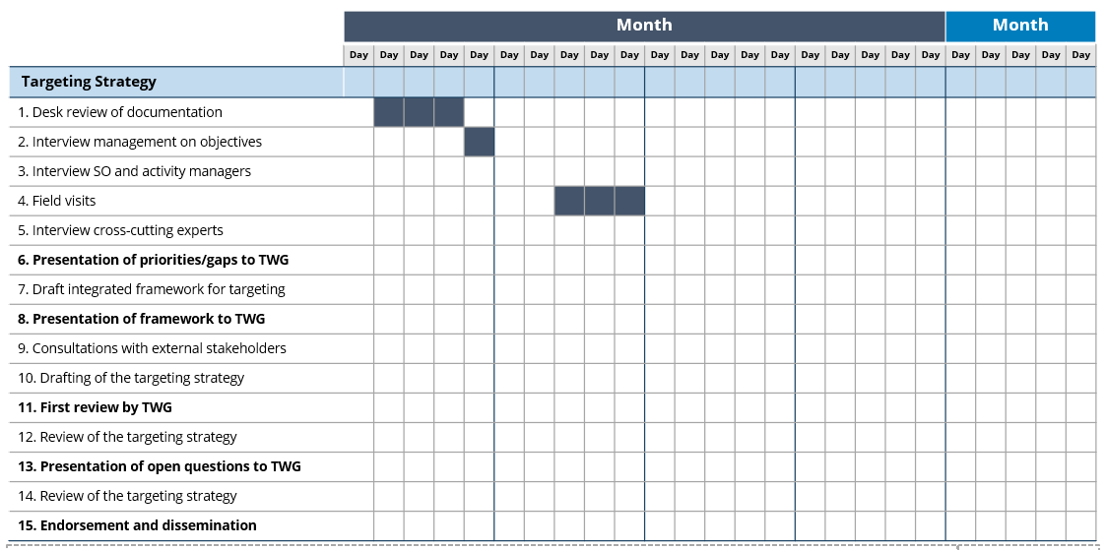
How to update the next steps
→ Identify someone who will keep an eye on the progress and follow-ups
→ 2-3 months might be needed to go through all the steps
Add months, days and color the appropriate boxes to create a Gantt Chart
Steps can be adjusted to the context of the CO

